Slide 1
Title
Predicting Student Math Score Dataset: StudentsPerformance[1].csv Group: group three
Date: 24/oct/2025

Slide 2
Goal
Task: Regression - Predict 'math score' from student features. Metric: RMSE, MAE, R²

Slide 3
Dataset
Rows: 1000 Columns: 8 Columns: ['gender', 'race/ethnicity', 'parental level of education', 'lunch', 'test preparation course', 'math score', 'reading score', 'writing score']

Slide 4
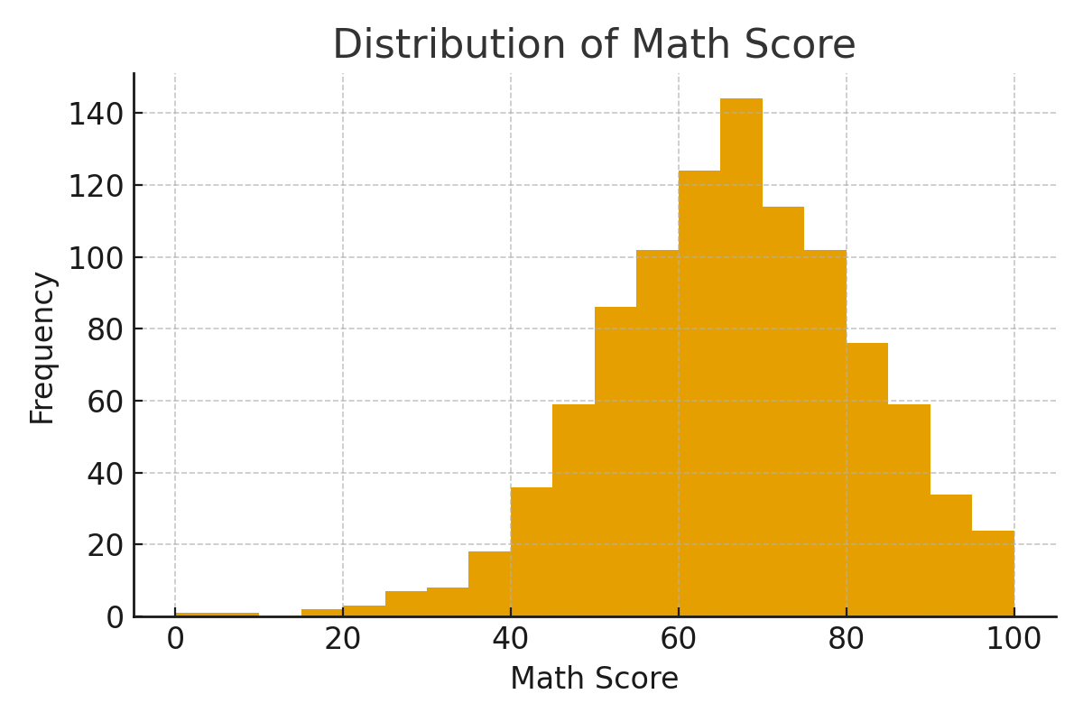
EDA - Univariate
Histogram of math score (see image)

Slide 5
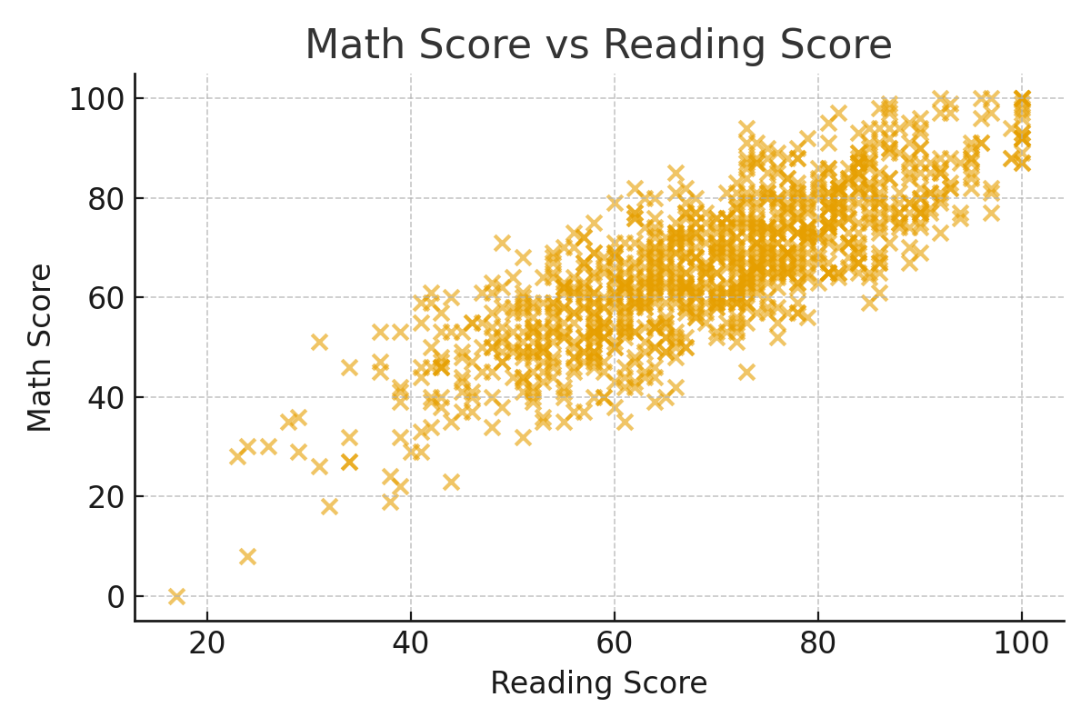
EDA - Multivariate
Scatter: math score vs reading score Correlation insights

Slide 6
Preprocessing
Impute missing values (if any), OneHotEncode categorical variables, split into train/test (80/20)

Slide 7
Models
1. Linear Regression (baseline) 2. Random Forest Regressor (non-linear)

Slide 8
Results
Linear Regression: RMSE=5.39, MAE=4.21, R2=0.88 Random Forest: RMSE=6.00, MAE=4.68, R2=0.85

Slide 9
Interpretation
Top feature importances (Random Forest): reading score: 0.5583 writing score: 0.2395 gender_male: 0.1204 lunch_standard: 0.0156 test preparation course_none: 0.0115 race/ethnicity_group E: 0.0106 parental level of education_some college: 0.0080 race/ethnicity_group C: 0.0069 parental level of education_high school: 0.0064 race/ethnicity_group D: 0.0060

